Slide 1


Slide 2

Announcements
Q-zips (ORDER NOW)
Next week is last session before christmas
Hackers VM available
Instagram giveaway
CTF Pathways - CTF Team
Red Team - Ethan/Charlie
Blue Team - Adam/Amara
OSINT/INT - Adam/Abbey
Networks/OT - Josh (TBC)

Slide 3
WiFi
Hacking 101
A beginners guide to WiFi hacking!
04/12/2025

Slide 4



DMUHACKERS
D0nt d0 1ll3gal sh1t
please..

Slide 5


What is WiFi?
WiFI (Wireless Fidelity) is a protocol that allows devices to connect and communicate wirelessly (Shocking fact i know)
Its based of the IEEE 802.11 standard which was came about in 1997, and uses radio waves to communicate. This is good as it allows more flexibility in networks, however also can be vulnerable to attacks if configured incorrectly or is old.

Slide 6

What is WiFi - 802.11

Slide 7
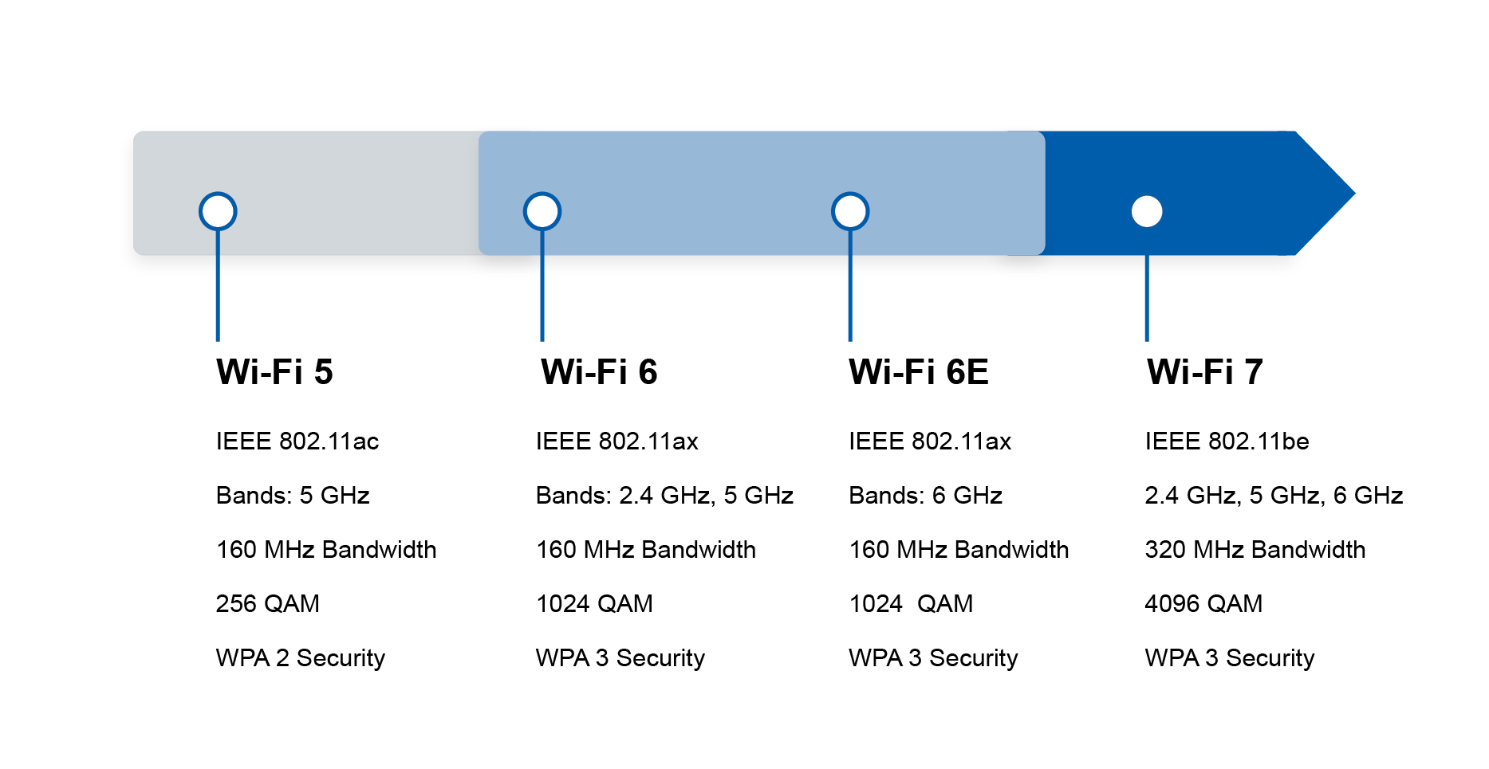
What is WiFi - WiFi versions

Slide 8


Bit of history for you all…

Slide 9

WEP
WEP is short for Wired Equivalent Privacy, and is a very outdated protocol that isn’t used anymore. It came around in 1997 and was the first attempt at security for WiFi via encryption to stop data interception.
WEP would encrypt the wireless traffic with either a 64 or 128 Bit key, that was static regardless of device, which is an obvious problem as if you got the key from a device, you got the data too.
As computers got more powerful it became easier to brute-force this key, therefore WEP was retired in 2004 (RIP).
WEP

Slide 10

WPA
WPA (WiFi Protected Access) was introduced in 2003 as the successor to WEP and was better in about every single way.
Instead of one key across all devices for the encrypted data,
WPA uses TKIP (temporary key integrity protocol), which made the key dynamic and harder to crack. TKIP was later superseded by AES.
WPA also included message integrity checks to see if an attack had intercepted or changed the packet, and also had a key of 256 bits for more security.
However it wasn’t perfect and was replaced 1 year later.

Slide 11
WPA2
WPA2 is the second iteration of WPA and comes in 2 flavours, WPA2-PSK and WPA2-EAP. These versions have some similarities the main one being they’re both based on the robust security network (RSN) mechanism and that they both use Counter Mode Cipher Block Chaining message authentication code protocol (CCMP).
WPA2-PSk is the home version that relies on passcode for access, whereas the WPA2-EAP is for enterprises and has its own quirks. Like said before they both use 128 bit CCMP, which is based off AES and an upgrade from TKIP from WPA, which makes it harder to spot patterns.
It’s still common today but isn’t perfect as susceptible to KRACK attacks, which i’ll explain later.

Slide 12
WPA3
And finally, WPA3 is the third and newest iteration of WPA and is becoming more widely adopted. It came about in 2018 and improved upon a lot of what WPA2 does, tho it hasn’t replaced it yet. There’s 3 main upgrades:
It uses individualised data encryption, it uses 256 bit GCMP and can add devices via QR code and NFC.
It uses a simultaneous hand shake to make sure the devices connect and are verified, which is very cool.
Its better at fighting brute force attacks as it allows only 1 attempt.
It's still very new though so wide adoption hasn’t been achieved, people still use WPA2 currently.

Slide 13

WPA2”
WPA3
WPA2”
WPA3

Slide 14



DMU HACKERS
I’m done boring you now, let’s talk the fun stuff

Slide 15

Common attack types
Like everything, none of these are perfect and have some vulnerabilities that can be used in these attacks, shown below:
Password brute-forcing - self explanatory
Packet sniffing - Kismet or Wireshark
Weak or out of date encryption - like WEP’s encryption process
De-authentication
Evil twins

Slide 16
De-authentication
This is a cool attack vector, by making a victims machine disconnect from the network it is connected to you make them need to reconnect.
This is good as it means you can capture what is being sent and exchanged when they do connect, and enables you to do some password cracking to get onto the network yourself. This is very effect on WPA 1 and 2, as they require passwords.
A helpful tool for this is called aireplay-ng, which we’ll come back to.

Slide 17
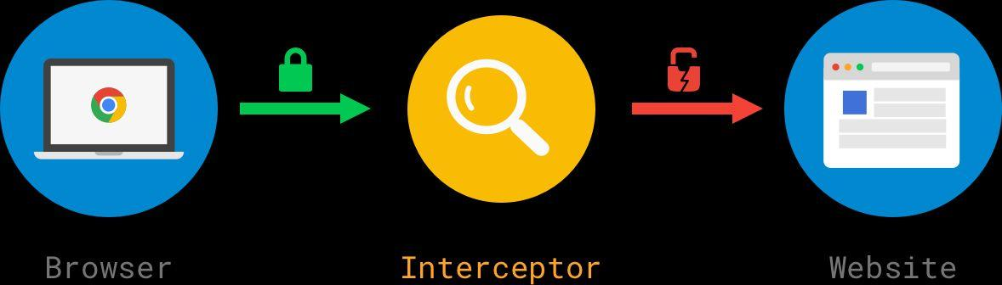
Evil Twins
This attack is fairly simple but effective attack. Basically a secondary router is set-up with an identical SSID to a legitimate network, meant to trick users.
This works as the user will get confused and may connect to your network instead of the real one, meaning all of their network traffic is sent through your machine. This allows you to monitor and examine what they do, possibly allowing for passwords or other sensitive info to be gathered.
This is the most common way to do a WiFi Man-in-the-Middle attack.

Slide 18


Evil Twins - Continued…
Sending traffic though your network also allows you to do some other things like cross-site scripting.
This is helpful as if they connect to something like a work database, you can edit their inputs and redirect the results or the data to you.

Slide 19
Side Topic - Microsoft Token
Microsoft has a big problem atm with stolen authentication tokens. Company emails are being breached (though they are keeping quiet), and mass phishing emails are being sent out because of it.
Called ‘microsoft token of truth attack’ and more and more attacks are happening and working. If you’re curious, this is the CVE - (CVE-2025-55241), and is cool to look into.
One way this could be happening is using an evil twin network, and capturing the authentication token when they log in, which gives them access to the users whole Entra ID (new form of Azure AD), and if they are high up, it's a big problem.

Slide 20






Basically microsoft’s security team
Microsoft’s R&D Department
(and Oracle HQ)

Slide 21

ARP Poisoning
So this isn’t WiFi but is a network based attack, plus its cool. Basically this is where an attacker will send forged and modified ARP replies to a host machine, which changes their ARP table, and means that any packets they try to send to machines, actually go to the attackers machine. So it’s another form or Man-in-the-Middle attack.
The ARP table contains the IP addresses and associated MAC addresses that the targets PC can communicate with, and the routes of which to go through to get there. So what the attack does is puts their MAC address with a legit IP, so they intercept the traffic.
Another attack worth looking at as very cool.

Slide 22

The classic - Denial of Service (DoS)
DoS attacks (Denial of Service):
When a machine or router get overloaded intentionally with packets and data by an attacker, so that it becomes very slow or unusable. This can be done locally with a machine on the network or remotely.
This is the same premise as a
DDoS attack (Distributed Denial of Service):
Where they attack the network to stop or reduce its function. The main difference is that a DDoS attack uses multiple compromised machines (BotNet), whereas DoS is just one machine.

Slide 23

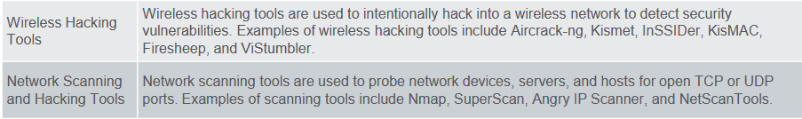
Tools
Right, now the even better part, some of the cool tools that you can use and have fun with. These have various uses from WiFi password cracking, interception, to network sniffing and password brute-forcing. These tools are:
Aircrack-ng
Aireplay-ng
Hydra
Wireshark
Kismet
Wifite
And more:

Slide 24

Wireshark
Wireshark is “the world's leading network protocol analyzer”
It is a very useful free tool that we can utilise to do the following:
Capture traffic on a network (sniff)
Analyse that traffic to gather information
This has multiple uses not just in a cybersecurity context, something as simple as a developer trying to diagnose a network issue with a newly deployed application or inspecting API calls…
Let's look at why wireshark is good to us as analysts…

Slide 25
Wireshark
Wireshark allows us to see raw 802.11 frames, this potentially will give us lots of useful information about a network, like…
Beacons
Probe requests/responses
Authentication mechanisms
Handshakes
Deauthentication frames
QoS frames

Slide 26
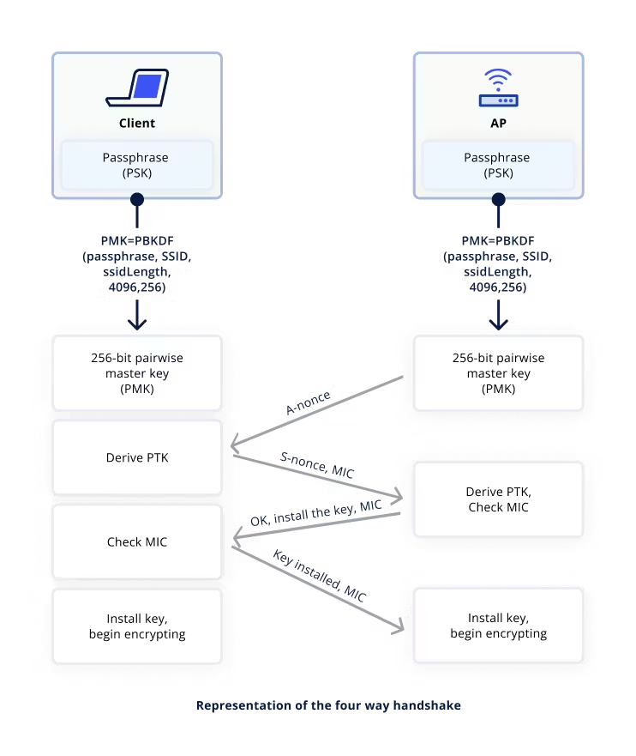
Wireshark - WPA2 Handshake Snooping
Using wireshark, we can inspect this handshake taking place.
If we are using aircrack-ng we can inspect whether the deauth packets have taken effect.
We can also capture the new handshake and then work to crack it :)
(this is where secure passwords come in)

Slide 27
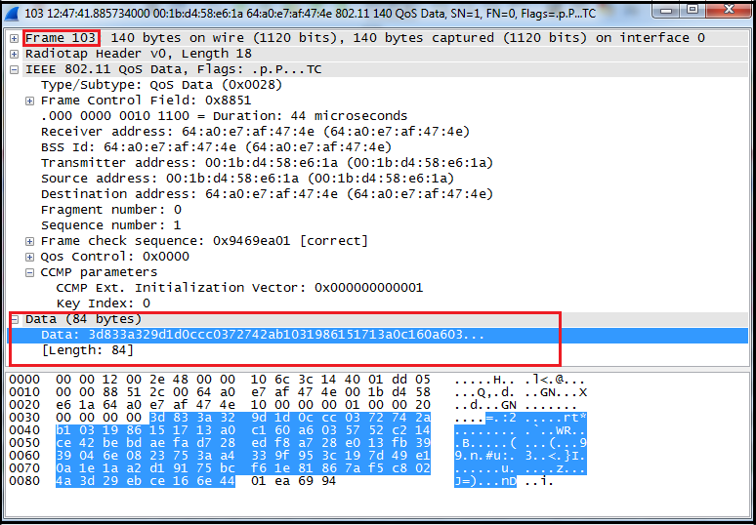
Wireshark - 802.11 frame…

Slide 28
Wireshark
Having said this, wireshark cannot crack a handshake and expose the plaintext credentials we want so badly…
However! In the aircrack-ng suite, we have a lovely tool called airmon-ng that does essentially the same thing as wireshark :)
Within the aircrack-ng suite it is nice and simple to pass data between the tools i.e. aireplay-ng, airmon-ng, aircrack-ng… It is almost like someone designed it to be an all-in-one suite

Slide 29
Wireshark - Defensive
Wireshark also can be used in a defensive context, to see if any foul play is occurring with our network, things such as:
Deauthentication attacks (e.g., from Aireplay-ng)
Evil Twin AP attempts
Rogue AP beacon flooding
WPS attacks
SSID spoofing
KRACK-style key reinstallation attempts

Slide 30
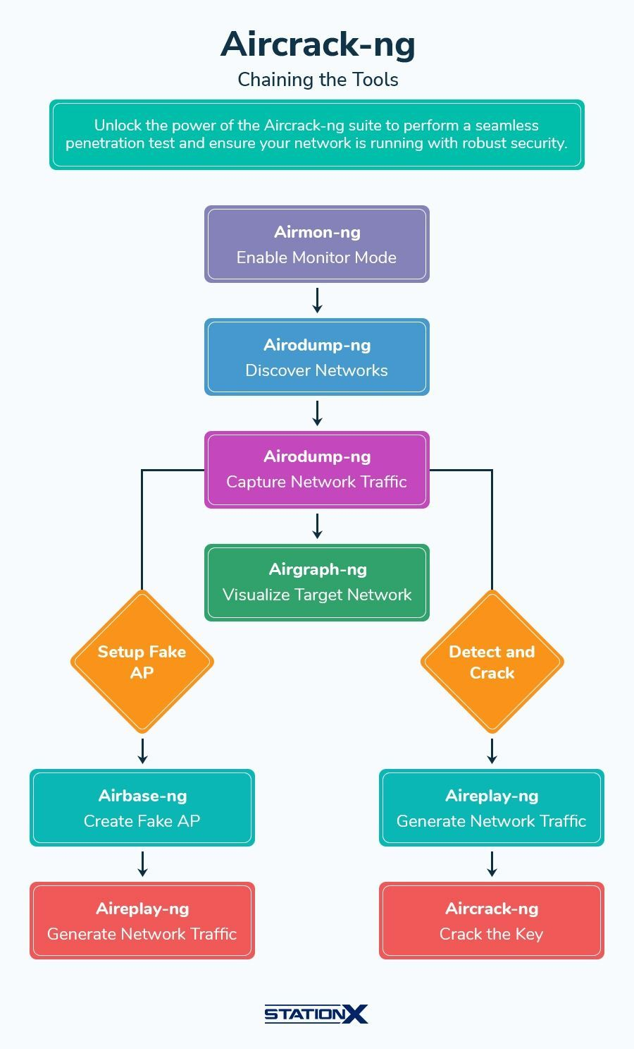
Aircrack-ng Suite
A suite of tools for WiFi pentesting and recon
Vary from monitoring to creating fake AP’s
Widely used as the base for other wifi tools too
Can also be used for testing drivers and driver compatibility
Most helpful tools include:
Airmon-ng
Airodump-ng
Aireplay-ng
Aircrack-ng

Slide 31

Airmon-ng
airmon-ng is the part of the tool suite that is used for network monitoring. This means it will keep track of all the traffic coming in and out of a network or specific AP.
It can also be used to terminate a connection to the network, which forces the given user to reconnect, which can be crucial for capturing connection or handshake data, allowing access to new parts of the network.
By using the common ‘sudo airmon-ng’ it will list wireless networks and their statuses, as well as show interfering processes with the
‘sudo airmon-ng check’ command.

Slide 32
Airodump-ng
Airodump-ng is the next tool you’ll want to use after airmon-ng, as it is used to capture the packets being sent, in raw 802.11 frames. This means it will be more effective against older WiFi security protocols, like WEP or the WPA handshake, compared to more modern versions.
This tool can be used in conjunction with the aircrack-ng tool, as it will collect the WPA handshake files, as mentioned before, that can then be cracked with aircrack-ng. This is good as it can reveal things like the passkey needed to access the network or more.
This tool has a lot of options, and I’d recommend looking here
for all details: https://www.aircrack-ng.org/doku.php?id=airodump-ng

Slide 33
Aireplay-ng
Aireplay-ng is best described as a packet injection tool, as it allows you to create and insert packets for a variety of attacks. It’s used to perform attacks on the network that cause traffic and deauthentication, which then allows things like the WPA handshake to be captured when devices reconnect.
However it’s not just to capture Handshakes, it is also used for fake authentications, ARP injection and poisoning, packet replay and more. This is a crucial tool which allows for so much data to be captured and discovered.
Note: when the syntax asks for a BSSID and an SSID, they are your AP’s
physical address (most likely MAC) and connection’s name respectively.

Slide 34
Aircrack-ng attacks
1. Put Your Wireless Adapter in Monitor Mode
This allows the adapter to capture raw Wi-Fi frames.
airmon-ng start wlan0
This usually creates an interface like wlan0mon.
2. Capture a WPA/WPA2 Handshake
You listen for packets from the target network until a client connects/reconnects.
airodump-ng wlan0mon
After identifying the target’s BSSID and channel:
airodump-ng -c <channel> --bssid <AP_MAC> -w capture wlan0mon
This begins writing packets into a .cap file

Slide 35
Aircrack-ng attacks
3. (Optional) Force a Handshake With Deauthentication
If no clients are joining, you can force a reconnect:
aireplay-ng --deauth 10 -a <AP_MAC> wlan0mon
This usually triggers a new handshake.
4. Crack the Handshake
Once you have a valid handshake, use Aircrack-ng with a wordlist:
aircrack-ng capture-01.cap -w /usr/share/wordlists/rockyou.txt
Aircrack-ng will test passwords until it finds the key.

Slide 36


Kismet
Kismet is a wireless sniffer but not just for WiFI, it’s also used for bluetooth, zigbee, RF and other wireless signals too.
It’s designed to identify networks, as well as sniff them and act as a WIDs (Wireless intrusion detection system). however, it’s main use to us is to identify hidden wireless networks and tell us what is on said networks.
This allows us to find an attack vector or at the least devices to look at more closely with other tools.

Slide 37

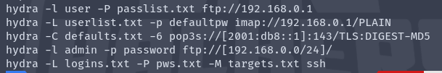
Hydra
Hydra is a cracking tool meant for use on networks and login credentials. It uses brute force and dictionary attacks to try and break into the given account or destination.
Hydra is good because it has high compatibility for different network protocols like HTTP, FTP, SSH, RDP (Remote Desktop Protocol), MySQL and more.
This versatility means it is a crucial tool as it opens the door to possibly access more areas and networks, meaning more data can be collected.
These are a few example use cases, however more can be found by doing ‘-h’:

Slide 38
Protecting your network
There are a few things you can do to keep you and your precious data safe, whether that’s on your own network or when connecting to a public one. So basically do these:
Use long and strong passwords, they make life more difficult
Keep an eye on what happens on your home network (or get a tool that does it for you)
Make sure your WiFi’s using WPA3 where possible and if not then WPA2, new is better for security and less time to find bugs.
USE A VPN ON PUBLIC NETWORKS
These steps help people who look like this
from stealing your data or worse:

Slide 39


Practical
https://tryhackme.com/room/
wifihacking101

Slide 40








Right it’s past my bedtime now. Let’s go drink!

